Slide 1
ZTE Customer Request Self-Service Portal Operation Guide V1.0.5
GCSC
2011-05

Slide 2
Course Objectives and Structure
Course Objectives
By the end of the course, the participants will
Have an outline of ZTE customer request self-service portal
Understand the basic request processing procedure
Be able to log and track requests, communicate with ZTE engineers, close requests and fill in the satisfactory survey
Course Structure
No. | Course Content | Importance | Hours
1 | Registration & Login | Medium | 5mins
2 | Request Processing Procedure & Operations | High | 30mins
3 | Q&A | High | 5mins
4 | Practice | High | 20mins

Slide 3
Contents
Introduction
Login Instruction
Request Processing Procedure
Create a Request
Search Requests
View a Request
Communicate on a Request
Close a Request
Annex: Search a Trouble Ticket Case

Slide 4
Introduction
This slide gives you a brief introduction on how to log and track customer requests in http://support.zte.com.cn, it allows you to
Create requests, including Consultation, Incident, Problem, etc.
Track the status of your requests
Communicate with ZTE support engineers on the requests
Close the requests and fill in the satisfactory survey

Slide 5
System Interface
For Internal Staff’s Reference Only!
Notes:
CSC system (http://csc.zte.com.cn), together with Support website, provides an integrated console to process and monitor requests generated from customers. The request tickets are transferred to CSC system as created by customers on the Support website. They can also be logged into CSC system directly by ZTE customer service representatives if customers report their requests via hotline or some other ways. Requests are processed in the CSC system.
This page illustrates the interface between CSC system and Support website.

Slide 6
Contents
Introduction
Login Instruction
Request Processing Procedure
Create a Request
Search Requests
View a Request
Communicate on a Request
Close a Request
Annex: Search a Trouble Ticket Case

Slide 7
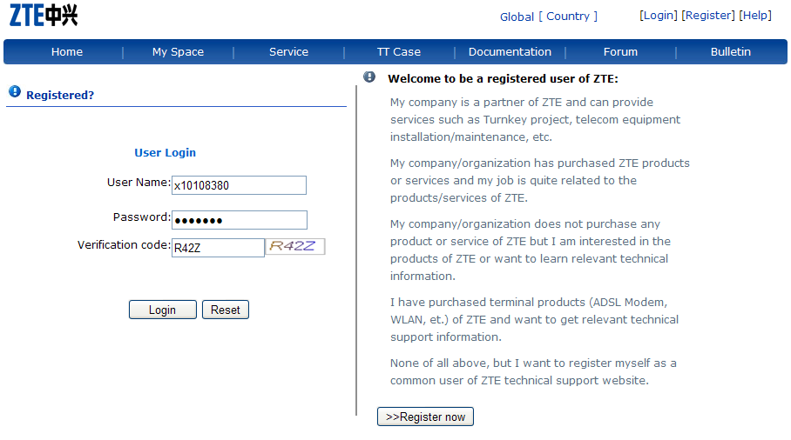
Login Instruction
1. Login entry
2. Input account, password and the verification code
3. Click here to log in

Slide 8
Registration
If you don’t have one account yet, you can start an registration procedure from here.
Or you could call ZTE hotlines for account registration.

Slide 9
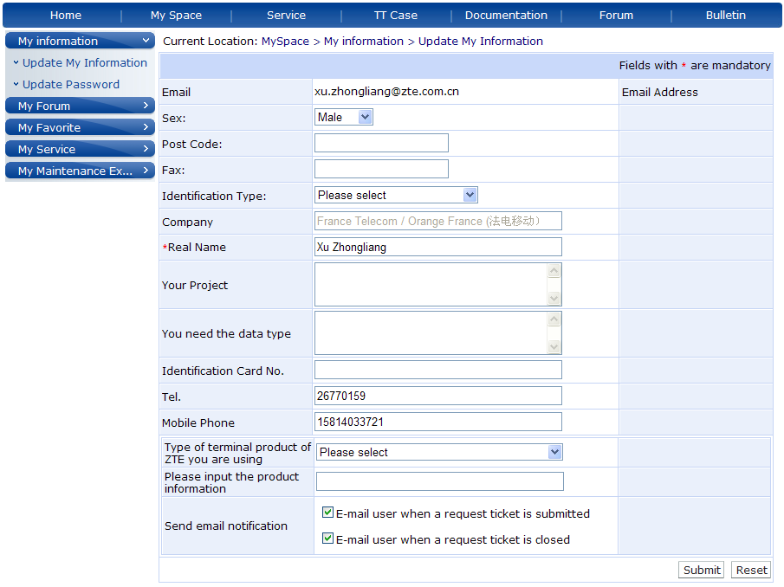
Update Personal Information
After login, you can
> update your account details
> subscribe the email notifications or
cancel the subscription
> change your password

Slide 10
Contents
Introduction
Login Instruction
Request Processing Procedure
Create a Request
Search Requests
View a Request
Communicate on a Request
Close a Request
Annex: Search a Trouble Ticket Case

Slide 11
Request Processing Procedure

Slide 12
Request Status
Under Creation: All the requests that have not been submitted.
Waiting for Response: All the submitted requests that have not been processed by supplier.
Working in Progress: All the submitted requests that are being processed and not suspended.
Pending Customer Action: All the requests that are suspended as waiting for customer action like information collection, or some other customer reasons.
Closure Validating: All the requests that have been submitted for closure approval, ticket consolidation, and request cancellation or rejection.
Closed: All the requests that have been closed, consolidated, cancelled or rejected.

Slide 13
Contents
Introduction
Login Instruction
Request Processing Procedure
Create a Request
Search Requests
View a Request
Communicate on a Request
Close a Request
Annex: Search a Trouble Ticket Case

Slide 14
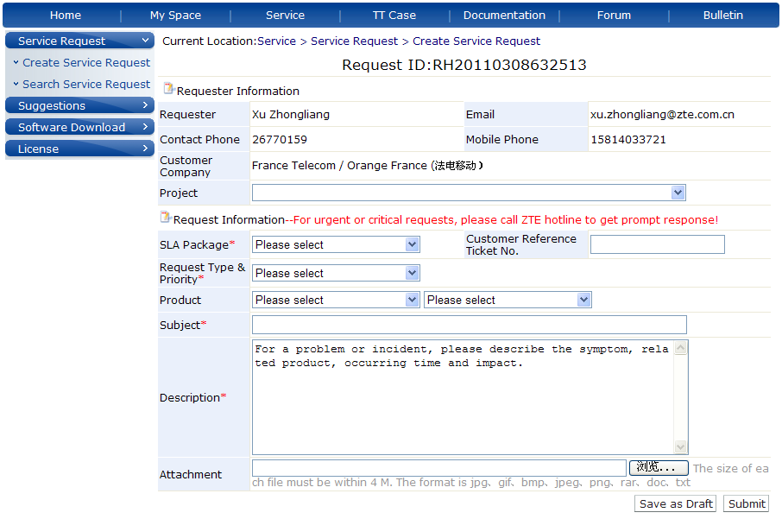
Create a Request
Fill in the request info.
Fields with “*” are mandatory
http://
This filed refers to the ticket ID in the customer’s ticketing System.
Leave it blank if no such information available
Add attachments here
Submit

Slide 15
Contents
Introduction
Login Instruction
Request Processing Procedure
Create a Request
Search Requests
View a Request
Communicate on a Request
Close a Request
Annex: Search a Trouble Ticket Case

Slide 16
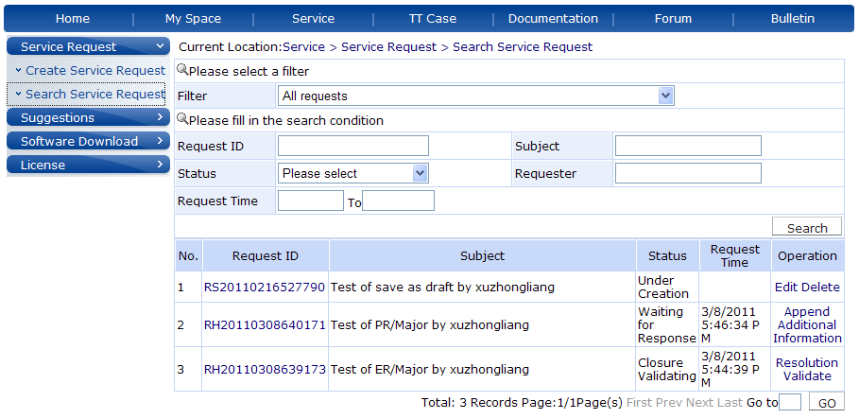
Search Requests
Select a filter
Enter the search conditions
Click here to search
For “Company-level” contact:
All SR of his/her company will be listed
For “Personnel-level” contact:
The SR submitted by himself/herself will be listed

Slide 17
Contents
Introduction
Login Instruction
Request Processing Procedure
Create a Request
Search Requests
View a Request
Communicate on a Request
Close a Request
Annex: Search a Trouble Ticket Case

Slide 18
View a Request – Entry
Click on the Request ID link to view the request details.

Slide 19
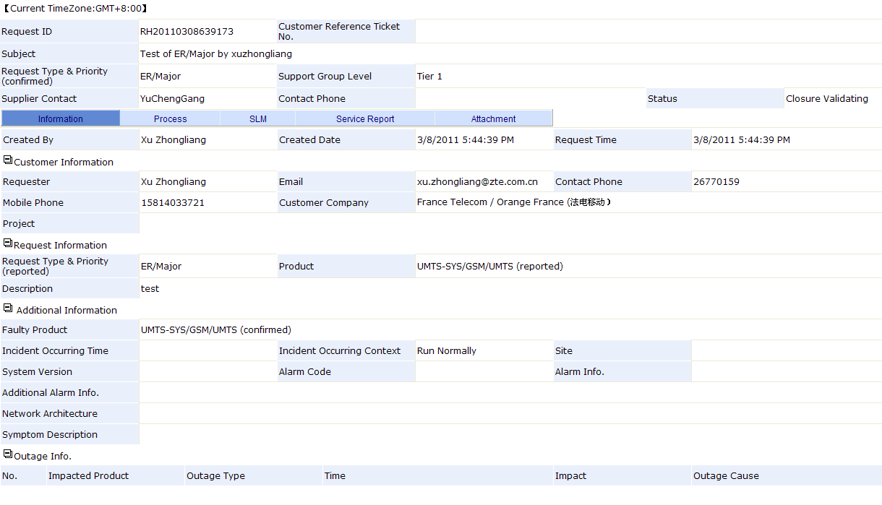
View a Request – Information
Current Request Status
Basic Information Tab
Requester Info. Block
Request Info. Block
Additional Info. Block
Outage Info. Block

Slide 20
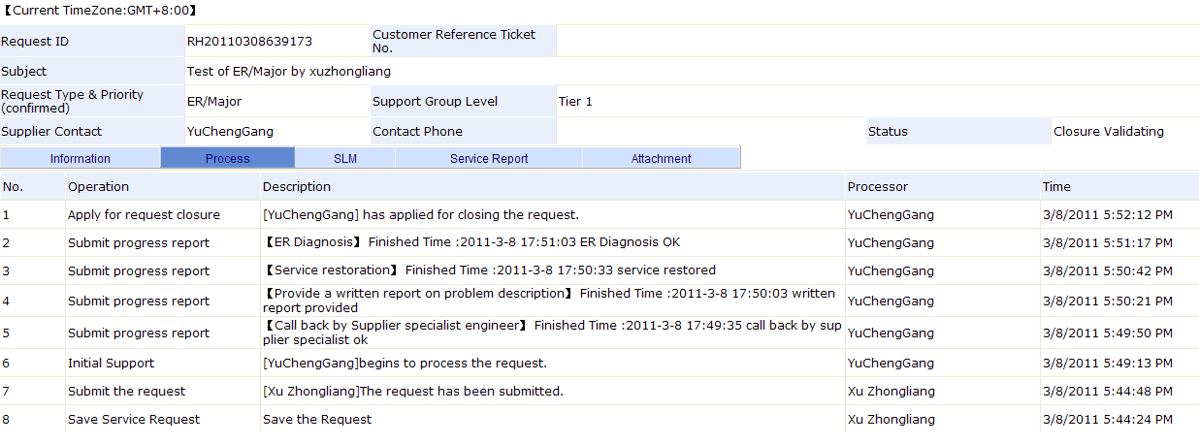
View a Request – Process
Processing Log Tab
Operations
Operation Description

Slide 21
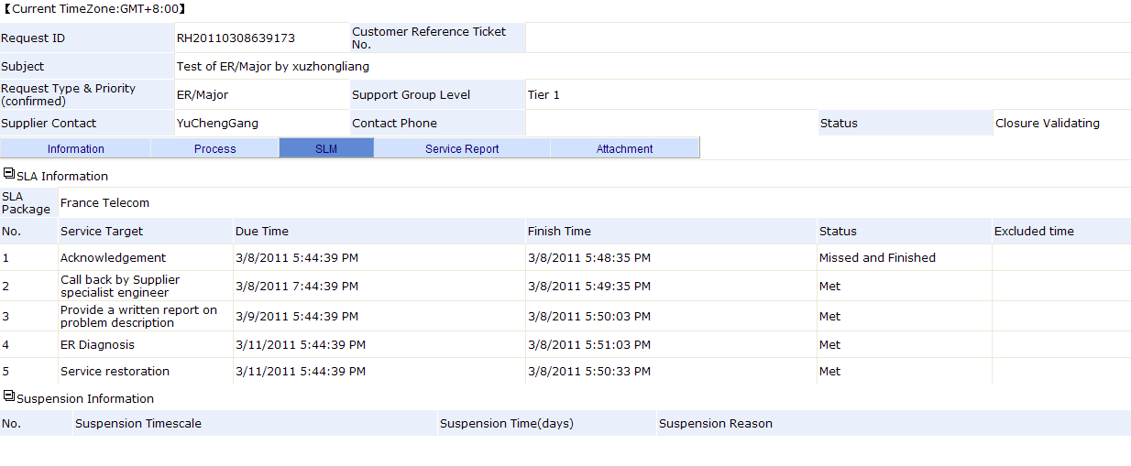
View a Request – Service Level Management
Service Level Management Tab
Contracted SLA
Service Targets
Recorded Suspension, If Any.

Slide 22
View a Request – Service Report
Service Report Tab
Reports as per each service target defined
in SLA package

Slide 23
View a Request – Attachment
Attachment Tab
Related attachments are listed here

Slide 24
Contents
Introduction
Login Instruction
Request Processing Procedure
Create a Request
Search Requests
View a Request
Communicate on a Request
Close a Request
Annex: Search a Trouble Ticket Case

Slide 25
Communicate on a Request
You can send some notes or attachments to ZTE engineers

Slide 26
Contents
Introduction
Login Instruction
Request Processing Procedure
Create a Request
Search Requests
View a Request
Communicate on a Request
Close a Request
Annex: Search a Trouble Ticket Case

Slide 27
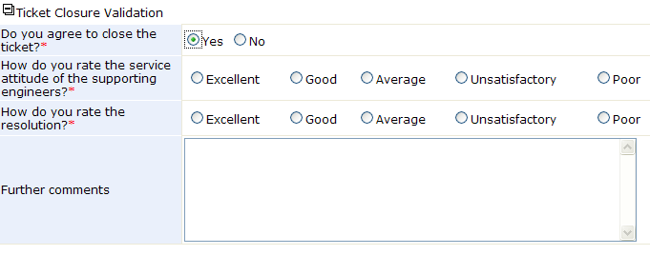
Close a Request
Resolution validation and service quality evaluation
Describe the reason if you think your request hasn’t been resolved yet.

Slide 28
Contents
Introduction
Login Instruction
Request Processing Procedure
Create a Request
Search Requests
View a Request
Communicate on a Request
Close a Request
Annex: Search a Trouble Ticket Case

Slide 29
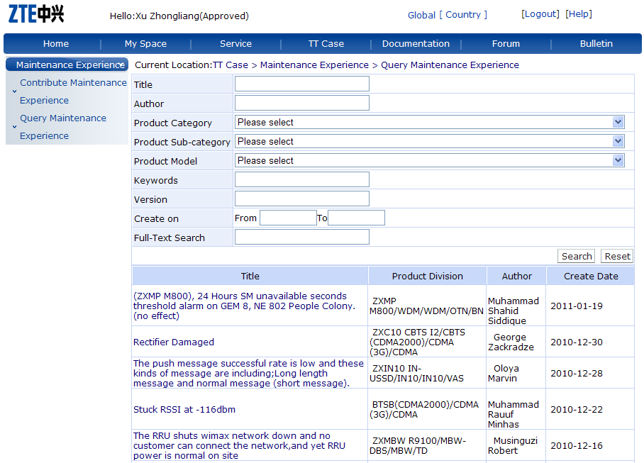
Annex: Search a Trouble Ticket Case
Trouble Ticket Case Entry
Enter the search conditions
Click the Search button
Results are listed
Click on the Title
link to view the
case details.

